Slide 1
Keep Alaska Moving
Alaska Department of
Transportation & Public Facilities
CMGC as an alternative project delivery method
November 18, 2015

Slide 2
CMGC @ ADOT&PF
Riley Creek – complete thru construction
  first horizontal CMGC project for ADOT&PF
  $11M (Federal)
  Bridge, national park, geotechnical issues
  Smaller project, fewer complexities
  Get good product and experience from CMGC
University Avenue – contractor selected
  $25M (Federal and State)
  Bridge, utilities, alternate routes, schedule, ROW, early work packages
  Larger project, many complexities
  Learn from Riley Creek – evolve

Slide 3
CMGC Overview
Procurement Type Comparison
CMGC Requires Collaboration During Design

Slide 4
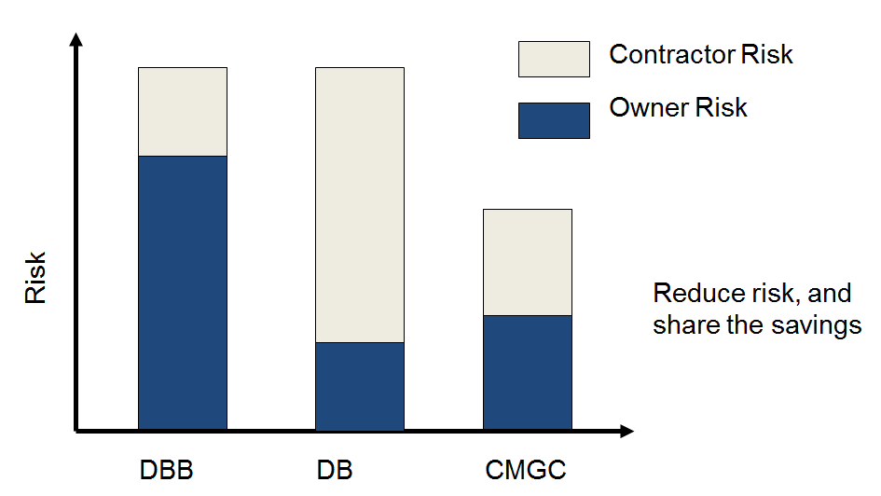
CMGC Overview
Risk Allocation

Slide 5
Horizontal vs. Vertical
Roadway work is predominantly 60-95% self performed (limited subcontracting)
  Min. self performance required by SSHC (30%)
  Subcontractor solicitation and competitive/price integrity
    Owner controlled solicitation, or independent by contractor?

Slide 6
H vs. V - Continued…
Independent Cost Estimator
  Involved in meetings, teleconferences, site visits, innovation and risk registers and discussions
  Bid the work like a competing contractor
    Approach to equipment, materials, labor pricing
    Solicit bids from subcontracted work independently
Confidential Estimates managed by Owner

Slide 7
H vs. V - Continued…
Owner challenges
  Project specific approval required by AAG
  Project identification, and timing of solicitation
  Qualified staff and resources dedicated to project (still have other projects to develop)
    In house, or consultant design?
  Managing and tracking specific CMGC project components
    Risk register, innovations, cost, contingencies, etc.
  Multi-discipline team – very “relational”

Slide 8
H vs. V – Continued…
More unknowns under a highway, or in a material source, than above a building foundation
(Deal with risk before money is on the table – different than DB and DBB)

Slide 9
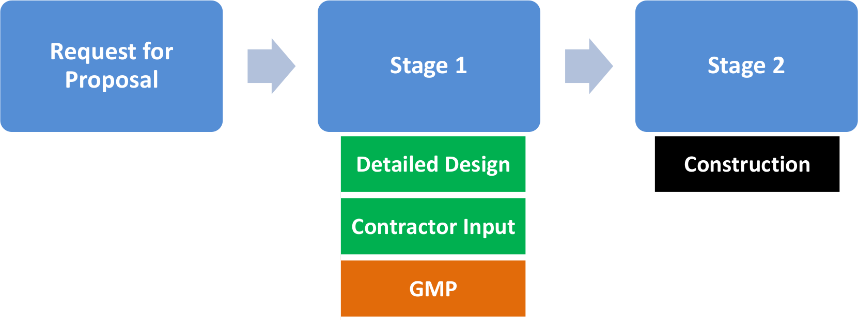
The acronym means what?
CM GC
Preconstruction
Notes:
Dave.

Slide 10
Solicitation
One Step
Qualifications Based
Price 10% minimum
Typical Criteria
  Approach to work, Innovation, Risk Management, Claims History and Past Performance
Transparency and early outreach key!
Score Proposals and Award Preconstruction Contract

Slide 11
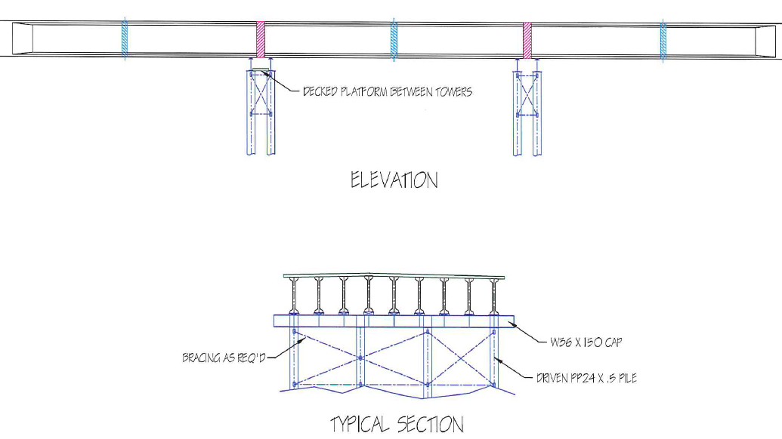
Contractor Input
Bridge alternatives
Constructability
Scheduling
Traffic control
Material availability
Risk management
Agency coordination
Permitting
SWPPP
Innovative products
Notes:
Lauren.

Slide 12
Pricing the work
Fair price strategy used to arrive at final cost.
  Engineer’s estimate
    Typically based on State averages
  Contractor Estimate
    Cost and mark-up identified separately
  Independent Cost Estimate (ICE)
    Cost validation
    “Competing Contractor” approach
Unit Price, Lump Sum (GMP), or blend (Bid Schedule) can be used.
OWNER
ICE
CMGC
Owner controls flow of information.
Notes:
Dave.

Slide 13
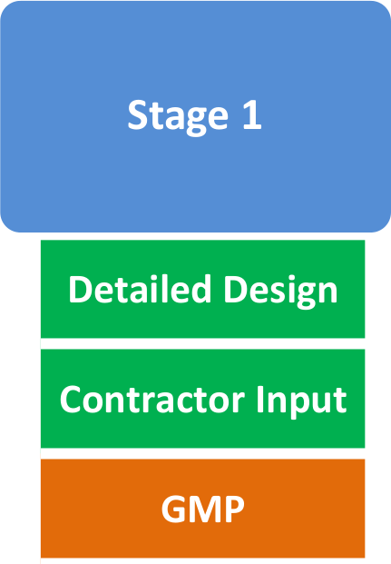
GMP (misnomer)
DOT&PF, ICE, and Contractor develop Guaranteed Maximum Price (GMP)
  Agreement reached – proceed to construction
  No agreement reached – proceed to competitive bid
Bid schedule vs. GMP
  Control risk through units, LS, or specific contingent sum items
Notes:
Dave.

Slide 14
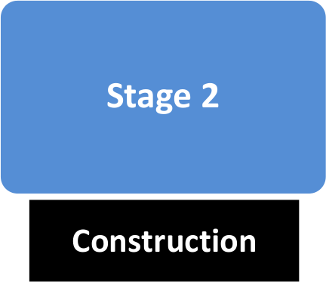
Construction
Begins with acceptance of Construction Cost (GMP or Bid Schedule)
  Bid award recommendation
  NTP
CMGC builds, ADOT&PF administers contract similar to Design-Bid-Build
Notes:
Dave.

Slide 15
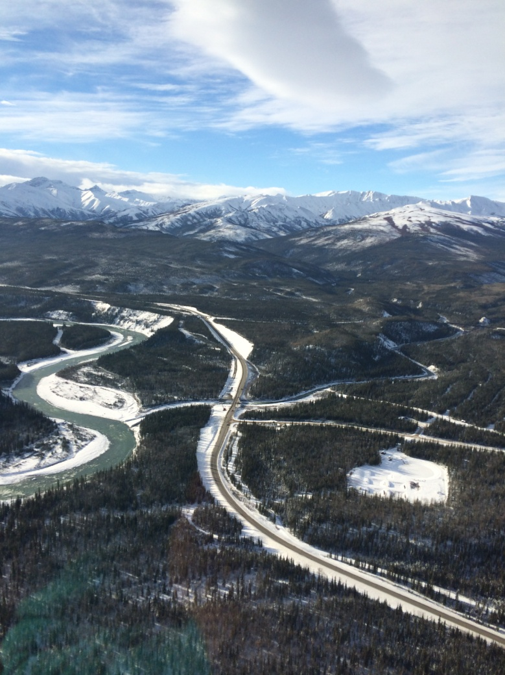
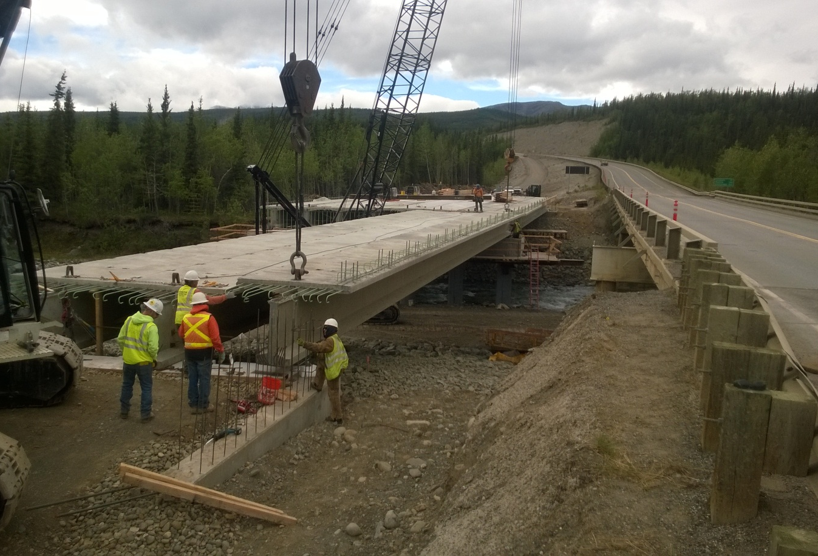
Riley Creek
Notes:
Dave.

Slide 16
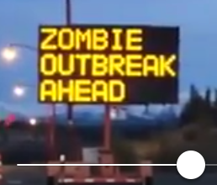
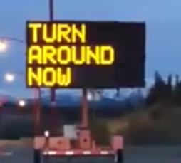
RC Risk
Risk Register
  Evolved during design
  Identified 40 risk items
Key Risk Items
  Seismic & Fault
  Pile excavation
  Schedule (seasonal weight restrictions)
  Traffic Control
Notes:
Hamilton – NPS concerns
Hamilton & DOT meeting with NPS solved problems on site; built credibility
NPS also communicated their view of risk

Slide 17
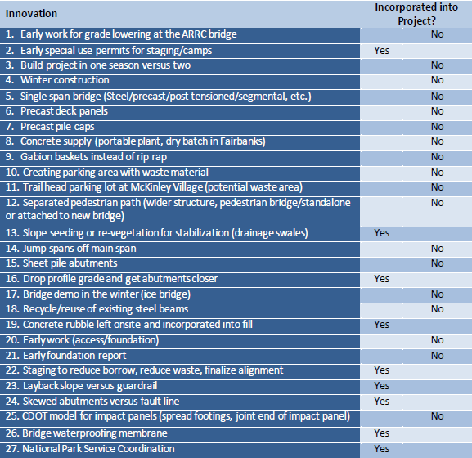
RC Innovation
Identified 27 potential innovations
Incorporated 9 innovations into the project

Slide 18
RC Schedule
Reduced Designer level of effort
Improved internal and external communication
Sense of urgency
Notes:
Lauren.

Slide 19
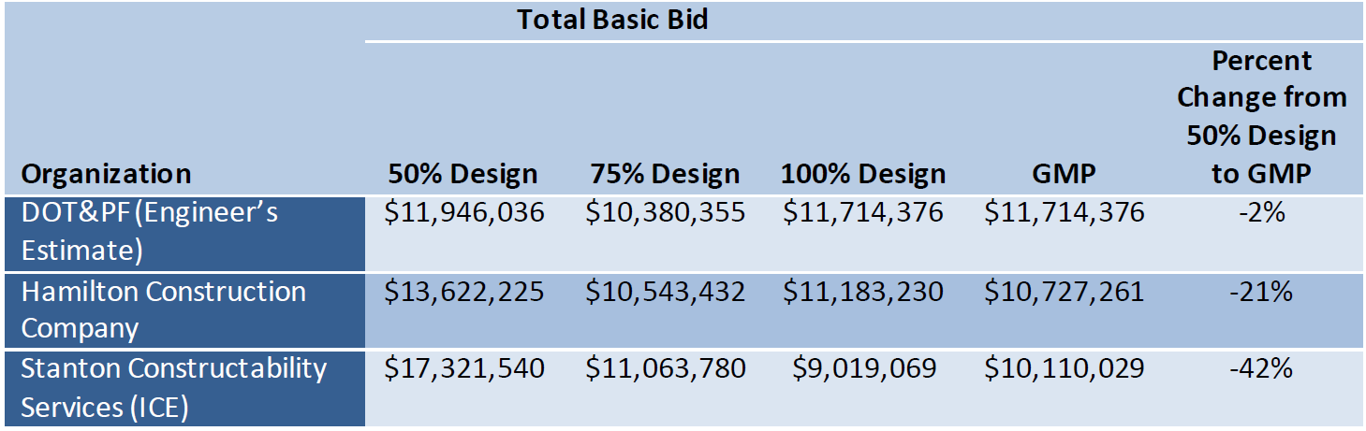
RC Cost
Estimates converged as design progressed
Bid Schedule Used for Riley Creek
  Risk Management tool
  Some LS, some Unit Price
Notes:
Dave.

Slide 20
RC Construction
Quality and conflicts
Change Orders
  In scope: (-$67,585.73)
    Value proposals (earthwork sub)
    Interaction with adjacent projects (delete contractor furnished items)
  Political scope: (+$1,195,500.00)
    Forced night-work due to adjacent projects and cumulative impacts

Slide 21
Questions?
Design:
    Lauren Little, P.E.
    (907) 451-5371
    lauren.little@alaska.gov
Construction:
    Michael Lund, P.E.
    (907) 451-5067
    michael.lund@alaska.gov
Project Websites:
http://dot.alaska.gov/nreg/rileycreek/
http://dot.alaska.gov/nreg/university/

